Slide 1
The Chemical Basis of Life

Slide 2
Key Words and Concepts
Element
Atom
Compounds
Molecule
Ions
Acid and base
Polar molecule
pH
Diffusion and osmosis

Slide 3
Review: Basic Chemistry
Matter
anything that has a mass and takes up a space.
Matter is composed of one or more elements
Element
is a substance that can not be broken down into simpler substances. Example: oxygen (O), hydrogen (H), carbon (C).
Each element has a set of properties that distinguish it from from other elements. Example: copper is a bronze colored solid that conducts heat; oxygen is odorless/colorless at room temperature.

Slide 4
Review: Basic Chemistry
Atom
is the smallest particle of an element that retains the characteristics of that element.
Example: all atoms of copper have the properties of copper
The center of each atom contains a nucleus composed of 2 different particles- protons (+ charge) and neutron (with no charge). Moving in regions outside the nucleus is a particle- electron (- charge)

Slide 5
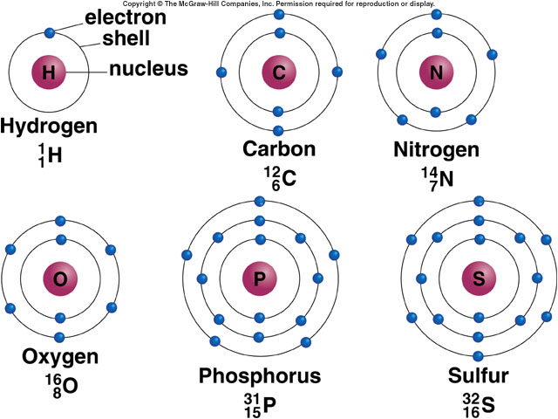
Structure of an Atom
5

Slide 6
Review: Basic Chemistry
Atom
Every atom in an element has an equal number of protons and electrons, and is electrically balanced, or neutral.
Every atom has energy, or the ability to do work.
This energy (called chemical energy), comes from electrons in the atom. Electrons are in motion and occupy certain regions in space depending on their energy. Electron closest to the nucleus have less energy than those farthest from the nucleus

Slide 7
Review: Basic Chemistry
Compounds
Substance made from elements are called compounds. A chemical formula shows the kinds of and proportions of of atoms in a compound (H₂O).
Molecules
Are the smallest units of a compound that still have the properties of that compound. (in H₂O, the ratio of H and O is 2:1, so the formula is H₂O)
Molecules are generally NEUTRAL.
Ions
Electrically charged (+ 0r -) molecules (atoms or groups of atoms) are called IONS.

Slide 8
Review: Basic Chemistry
Ions and Ionic bonding
In some kind of compounds, atoms may lose or gain electrons (no longer is electrically neutral). Example:
Chlorine Sodium
Atom Ion Atom Ion
17p+ 17p+ 11p+ 11p+
17e- 18e- 11e- 10e-
0 charge -1charge 0 charge +1 charge
Symbol: Cl- Symbol: Na+
The negative chloride ion and the positive sodium ion are attracted to each other. This attraction between oppositely charged ions is called an IONIC BOND.

Slide 9
Review: Basic Chemistry
Polar Molecules
Molecules with uneven distribution of electrical charges. That is, positive and negative charges within the molecule tend to congregate separately from one another.
A POLAR MOLECULE is any molecule with unbalanced charge distribution.
This unbalanced charge distribution makes water a polar molecule.

Slide 10
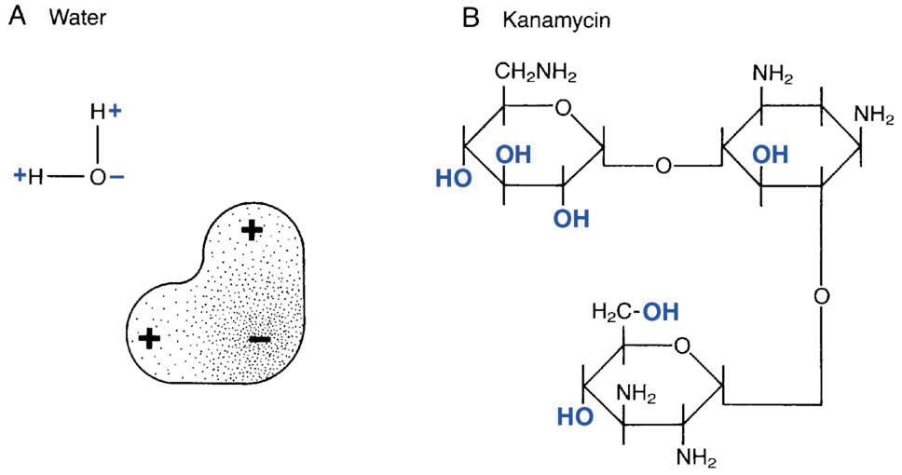
Review: Basic Chemistry
Polar Molecules
Example: Even though water molecules have same number of electrons and protons, the distribution of these charges is uneven (areas near the oxygen atom are negatively charged and areas near the hydrogen atoms are positively charged)

Slide 11
Review: Basic Chemistry
Acids and Bases
Two common groups of compounds that react in water are ACIDS and BASES.
Acid is any substance that releases hydrogen ions (proton) when mixed with water (PROTON DONOR)
Example: CH₃COOH --–H₂0– H⁺ + CH₃COO–
Base is a substance that separates in water, forming ions that react with hydrogen ions (PROTON ACCEPTOR)
Example: NaOH + CH₃COOH --– H₂0 + CH₃COONa

Slide 12
Review: Basic Chemistry
pH
The strength of an acid or base is measured by the pH scale (0-14, 7 being neutral: water)
pH of acid solution: 0-7; of basic solution 7-14
The pH scale is based on powers of 10. Thus Cola with a pH of 3 is 10 times more acidic than Tomato juice with a pH of 4.
Living cells are very sensitive to pH of their environment. Our cells are bathed in a fluid that has a pH of 7.2 (if the pH changes by only 2/10th of a point in either direction, cells may die).

Slide 13
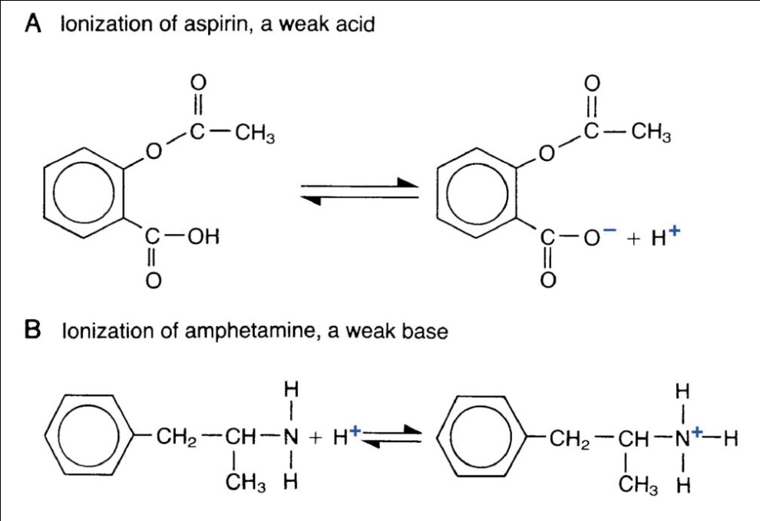
Review: Basic Chemistry
Ionization
The process of becoming charged (ion) is called ionization.
Acids tend to become ionized in basic (alkaline) media
Bases tend to ionize in acidic media

Slide 14
Review: Basic Chemistry
pH Dependant Ionization
Example: Aspirin is an acidic molecule- in the stomach (acid environment) it remains non-ionized and can pass into the blood; once it moves to the intestine where it is basic, the aspirin becomes ionized and cannot cross the membranes into the blood

Slide 15
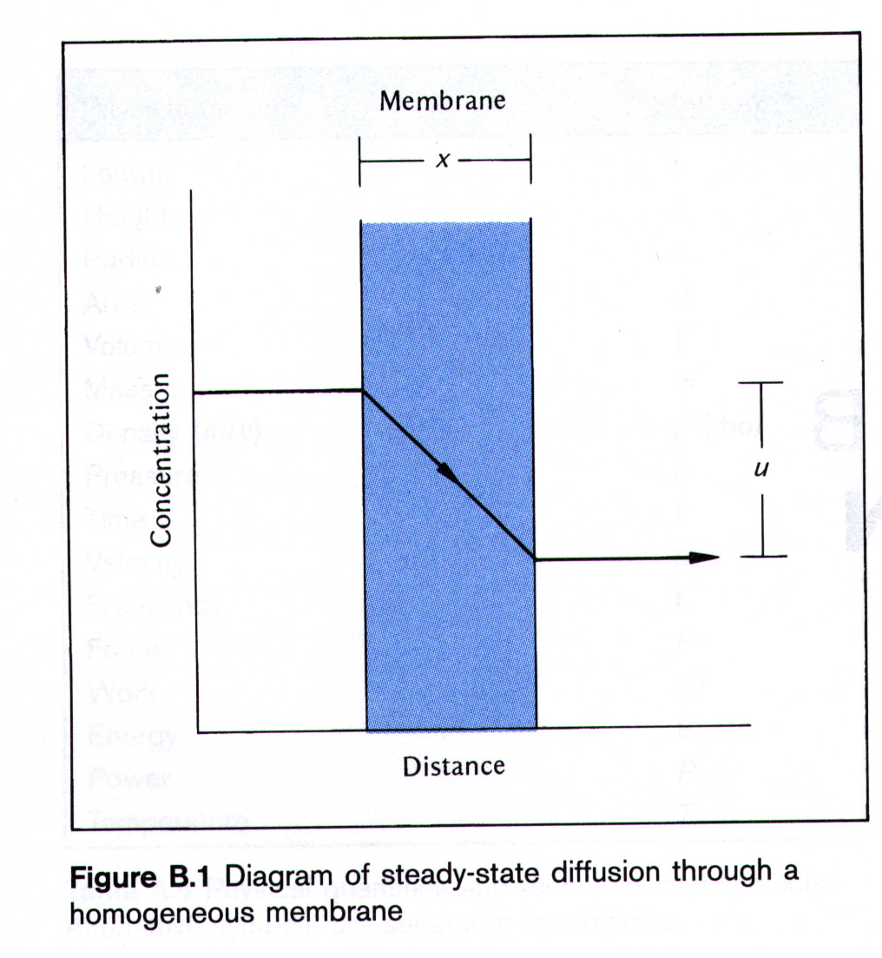
Review: Basic Chemistry
Diffusion and Osmosis
Diffusion : movement of a molecule/substance from a higher to a lower concentration
Osmosis : movement of water molecules through a semi-permeable membrane from a higher to a lower water concentration

